Slide 1





Artificial Intelligence for the targeted generation of novel compounds
Joel P. Arrais – jpa@uc.pt https://joelarrais.github.io
DEI/CISUC - University of Coimbra

Slide 2
Bio and research interests
Short bio:
Assistant Professor @University of Coimbra
Researcher @ Laboratory of Artificial Neural Networks (LARN) /CISUC
Teaching: Bioinformatics and Machine Learning Courses
Research lines:
Sequence based classifiers to predict protein/drugs interactions
Inference of signaling networks responsible for the gene expression change over time.
Deep Generative models for improving the drug discovery pipeline
Disclaimer:
No previous work on P2X receptors
No wet lab experience

Slide 3
1. PARADIGM Shift

Slide 4
Data driven research
Bioinformatics/ComBio is moving from a data analysis paradigm to a data driven research.
Statistics and Machine Learning have been successfully used to analyse data from experiments (post-mortem).
Two emerging factors:
The large scale of the multi-omics data publicly available.
Developments on Artificial Intelligence algorithms and major advancements on hardware to run them.

Slide 5
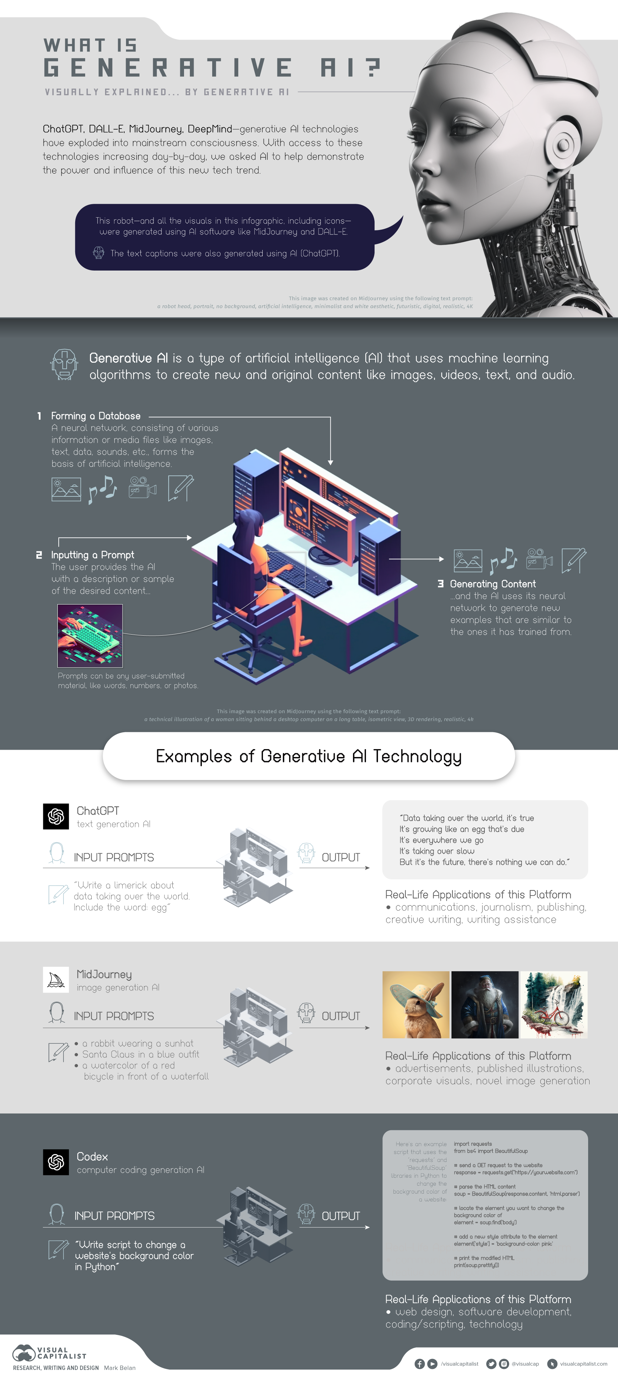
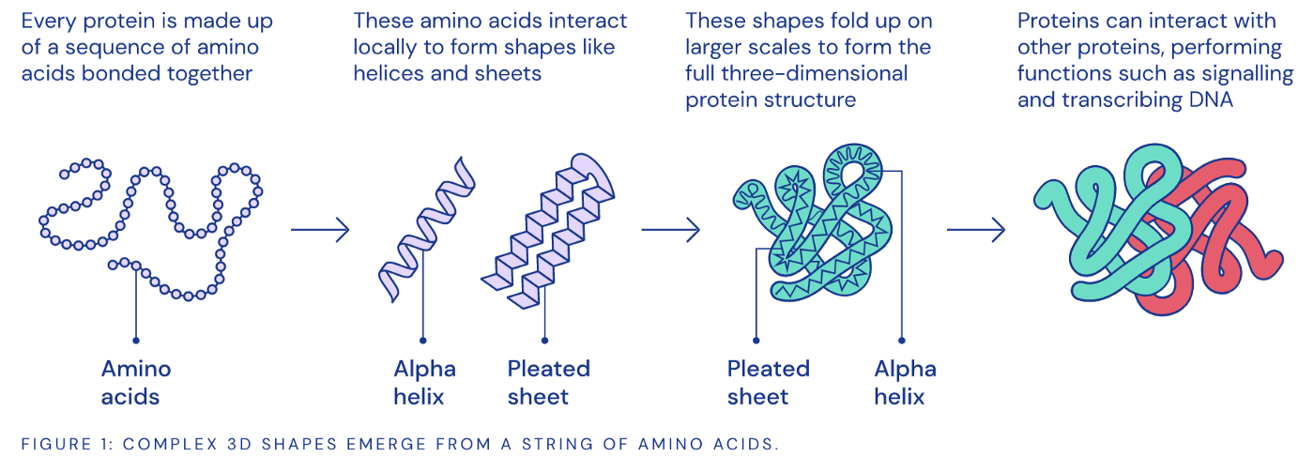

Generative models

Slide 6
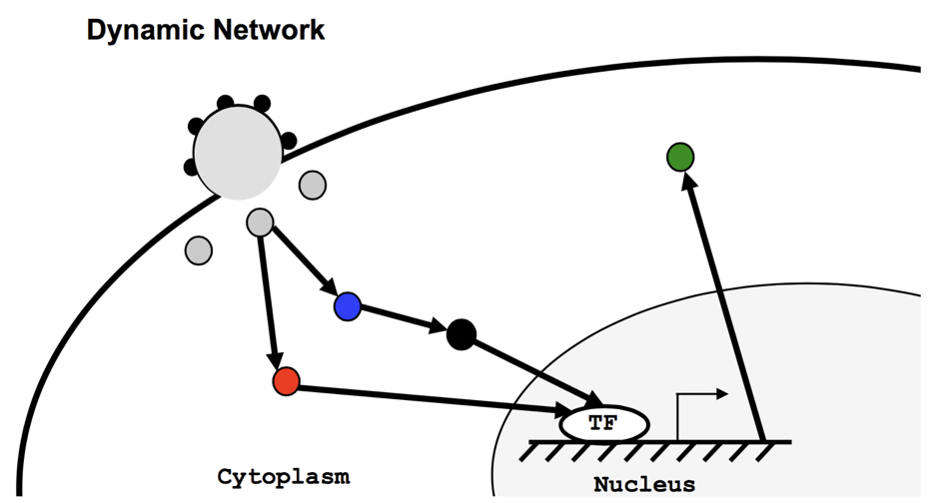
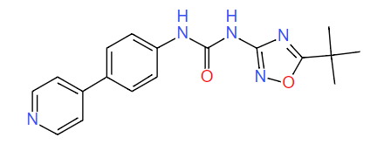
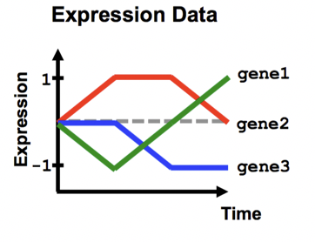
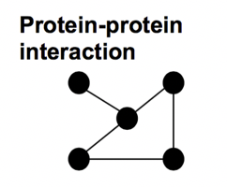
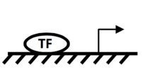
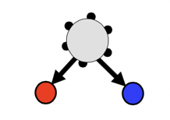

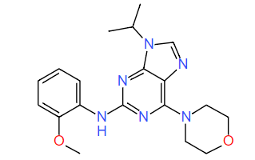
Protein target plus:
- Base fragment
- Parameterization
- Other restrictions
Generative model
Reward function
(ex. binding affinity)
CC(C)(C)c1nc(NC(=O)Nc2ccc(-c3ccncc3)cc2)no1
Evaluation Model
Candidate molecule
COc1ccccc1Nc1nc(N2CCOCC2)c2ncn(C(C)C)c2n1

Slide 7
2. Gene expression
Temporal progression of HIV-1 immune response pathways

Slide 8
Design of a microarray experiment
Two color arrays compare two RNA samples, e.g., normal vs mutant
Channel 1 emission proportion to gene expression in Mutant, and Channel 2 to normal RNA

Slide 9
Gene expression case study
Distinct types of diffuse large B-cell lymphoma identified by gene expression profiling, doi:10.1038/35000501
Diffuse large B-cell lymphoma (DLBCL) is clinically heterogeneous: only 40% of patients respond well to current therapy (...), whereas the remainder succumb to the disease.
We proposed that this variability (...) reflects unrecognized molecular heterogeneity in the tumours
We identified two molecularly distinct forms of DLBCL which had gene expression patterns indicative of different stages of B-cell differentiation.
~1.8 million measurements from 128 microarrays of 96 samples of normal and malignant
The molecular classification of tumours on the basis of gene expression can thus identify previously undetected and clinically significant subtypes of cancer.
Notes:
Llibraries derived from DLBCL, follicular lymphoma (FL), mantle cell lymphoma and chronic lymphocytic leukaemia (CLL).

Slide 10
Clustering both samples and genes
Approx. 1.8 million measurements of gene expression from 128 microarray analyses of 96 samples of normal and malignant lymphocytes.
From: Nature February, 2000 Paper by A Alizadeh et al, Distinct types of diffuse large B-cell lymphoma identified by Gene expression profiling
Notes:
Legend: Depicted are the 1.8 million measurements of gene expression from 128 microarray analyses of 96 samples of normal and malignant lymphocytes. The dendrogram at the left lists the samples studied and provides a measure of the relatedness of gene expression in each sample. The dendrogram is colour coded according to the category of mRNA sample studied (see upper right key). Each row represents a separate cDNA clone on the microarray and each column a separate mRNA sample. The results presented represent the ratio of hybridization of fluorescent cDNA probes prepared from each experimental mRNA samples to a reference mRNA sample. These ratios are a measure of relative gene expression in each experimental sample and were depicted according to the colour scale shown at the bottom. As indicated, the scale extends from fluorescence ratios of 0.25 to 4 (-2 to +2 in log base 2 units). Grey indicates missing or excluded data.

Slide 11
Clustering samples

Slide 12
Material and Methods
Material:
Expression profile for the HIV infection
mRNA expression profiling for 12 time points over 24 hours
Seed nodes for the HIV mechanism
Transcription Factors; Protein-DNA interactions
Human Protein-Protein interaction network
Methods:
Path Filtering
Problem formulation and IP model implementation
Objective function
Maximize the number of targets explained
Maximize the weight of the selected paths
Minimize the number of nodes

Slide 13
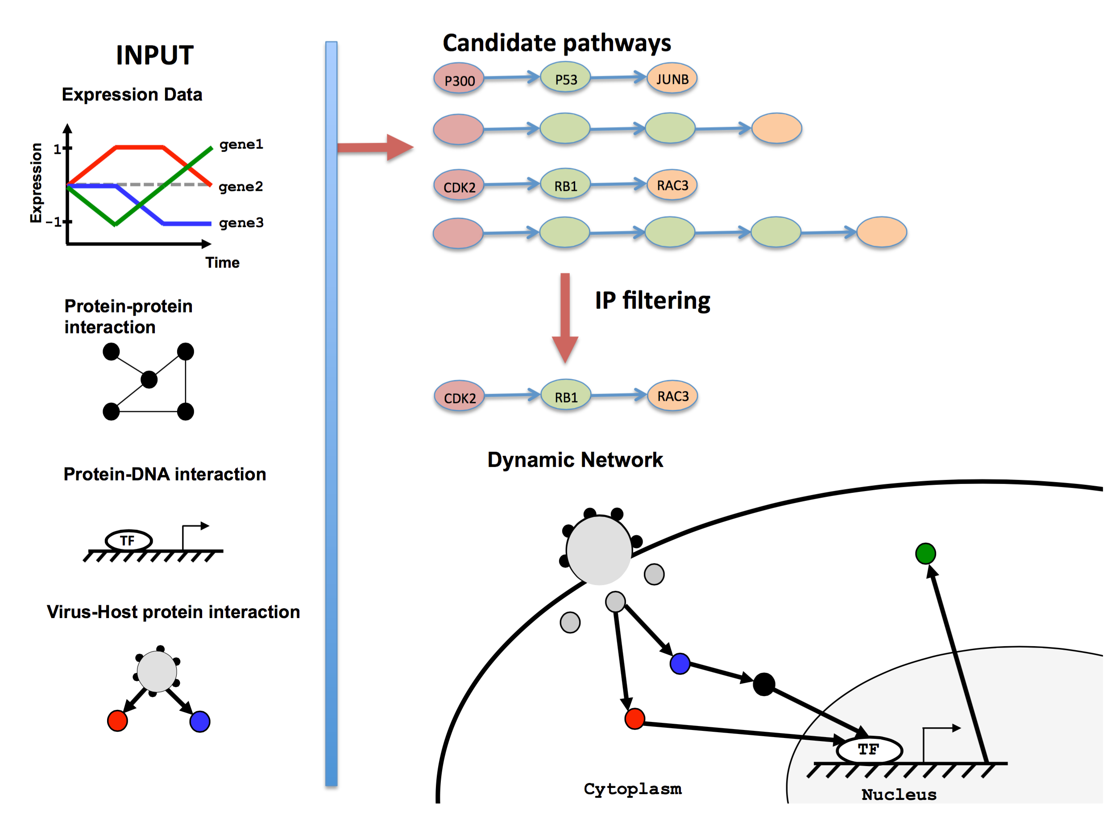

Slide 14
Motivation
Problem:
Most methods for reconstructing signaling and regulatory response networks from high throughput data generate static models which cannot distinguish between early and late stages in the response
Hypothesis:
Given time series gene expression data and host proteins that a virus or drug interacts with, it is possible to infer the signaling pathways that are responsible for the gene expression change over time.
A cell is in a stationary state
A perturbation is induced (external condition; Virus; bacteria)
What are the response mechanisms to this event?
BETTER PUT: What are the chain of response pathways to this event?

Slide 15
Temporal constraint
Hypothesis — differential expression at later time points is affected by differential expression at earlier time points.
Implementation in model — if a signaling pathway ends at a differentially expressed gene at time point T, then there must be a differentially expressed gene from a previous time point.

Slide 16
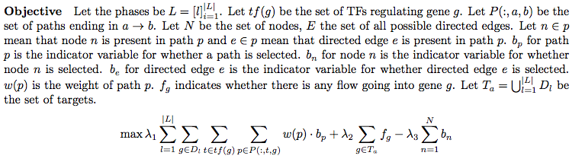
IP formulation
For scalability Proteins (and not paths) are considered as variables. Variables are Boolean.
Global objectives:
Maximize path weight, λ₁
Maximize the number of targets explained, λ₂
Minimize the number of intermediate nodes, λ₃

Slide 17
In silico validation
siRNA screenhits
siRNA binds to mRNA disabling its translation to proteins (gene silencing)
A library with siRNAs for all human genes is inserted in the cell (~20k) For the cells that survived screen the active siRNAs.
A meta-analysis of the previous three available studies determined that only common 3 proteins.
Studies from (Hela/TZM-bl and 293T). We have used Sup-T1 cells.
A total of ~300 sequences were selected
Overlap with Reactome HIV pathways
Reactome is a database of metabolic pathways
It has 21 HIV infection related pathways
The overlap will give a good measure of confidence
Notes:
Note that the RNAi knockdown screens discussed above were performed on a different cell type (Hela/TZM-bl and 293T) and so, while they are useful for statistical validation, they may not completely reflect pathways activated in Sup-T1 cells.

Slide 18
Results - IP
λ2
λ3
λ2
λ3
λ2
λ3
λ2 | λ3 | #Paths | #Proteins | #Sources | #Targets | #Top100 screen hits | #Reactome Paths
0 | 0 | 218959 | 3270 | 163 | 278 | 25 | 403
17 | 81 | 209608 | 1869 | 162 | 271 | 25 | 402
1 | 81 | 124002 | 470 | 138 | 121 | 25 | 377
1 | 161 | 28794 | 134 | 57 | 32 | 24 | 184

Slide 19
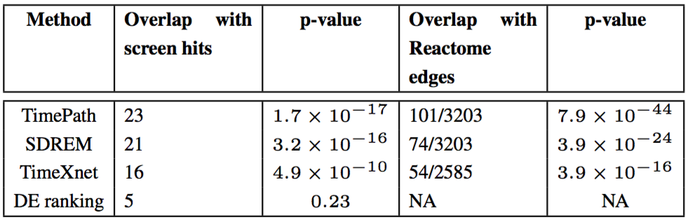
Comparison
Overlap between RNAi screen hits and top 100 genes for the different dynamic network reconstruction methods
Edge list from Reactome and the edges extracted by the different methods.
Comparison with a baseline ranking of the differentially expression (DE) genes is also presented.

Slide 20
TimePath (http://sb.cs.cmu.edu/timepath)
3 time phases x 3 iterations
Notes:
Figure 2. Dynamic signaling and regulatory network for HIV-1 immune response. The red nodes are the host proteins that interact with the HIV-1 proteins (selected sources). Blue nodes are intermediate signaling proteins and green nodes are the TFs that are predicted to directly up/down-regulate the differential expression of target genes (targets not shown in figure, but the average levels of the regulated targets for each TF is presented by the yellow nodes while the size of each of the yellow nodes indicates how many genes belong to the cluster represented by the node). The figure displays the top predicted nodes for each of the three phases and also demonstrates is directly linked to the sources via the signaling proteins and DE genes in earlier phases. Diamond shaped nodes were identified as supported RNAi screen hits (text) and rectangular nodes are targets for the phase they are in. Nodes with bold blue border represent proteins we experimentally tested. Note that some intermediate proteins may also be TFs. The functional role in the network figure is based on the location of the protein in the selected paths based on the IP.

Slide 21
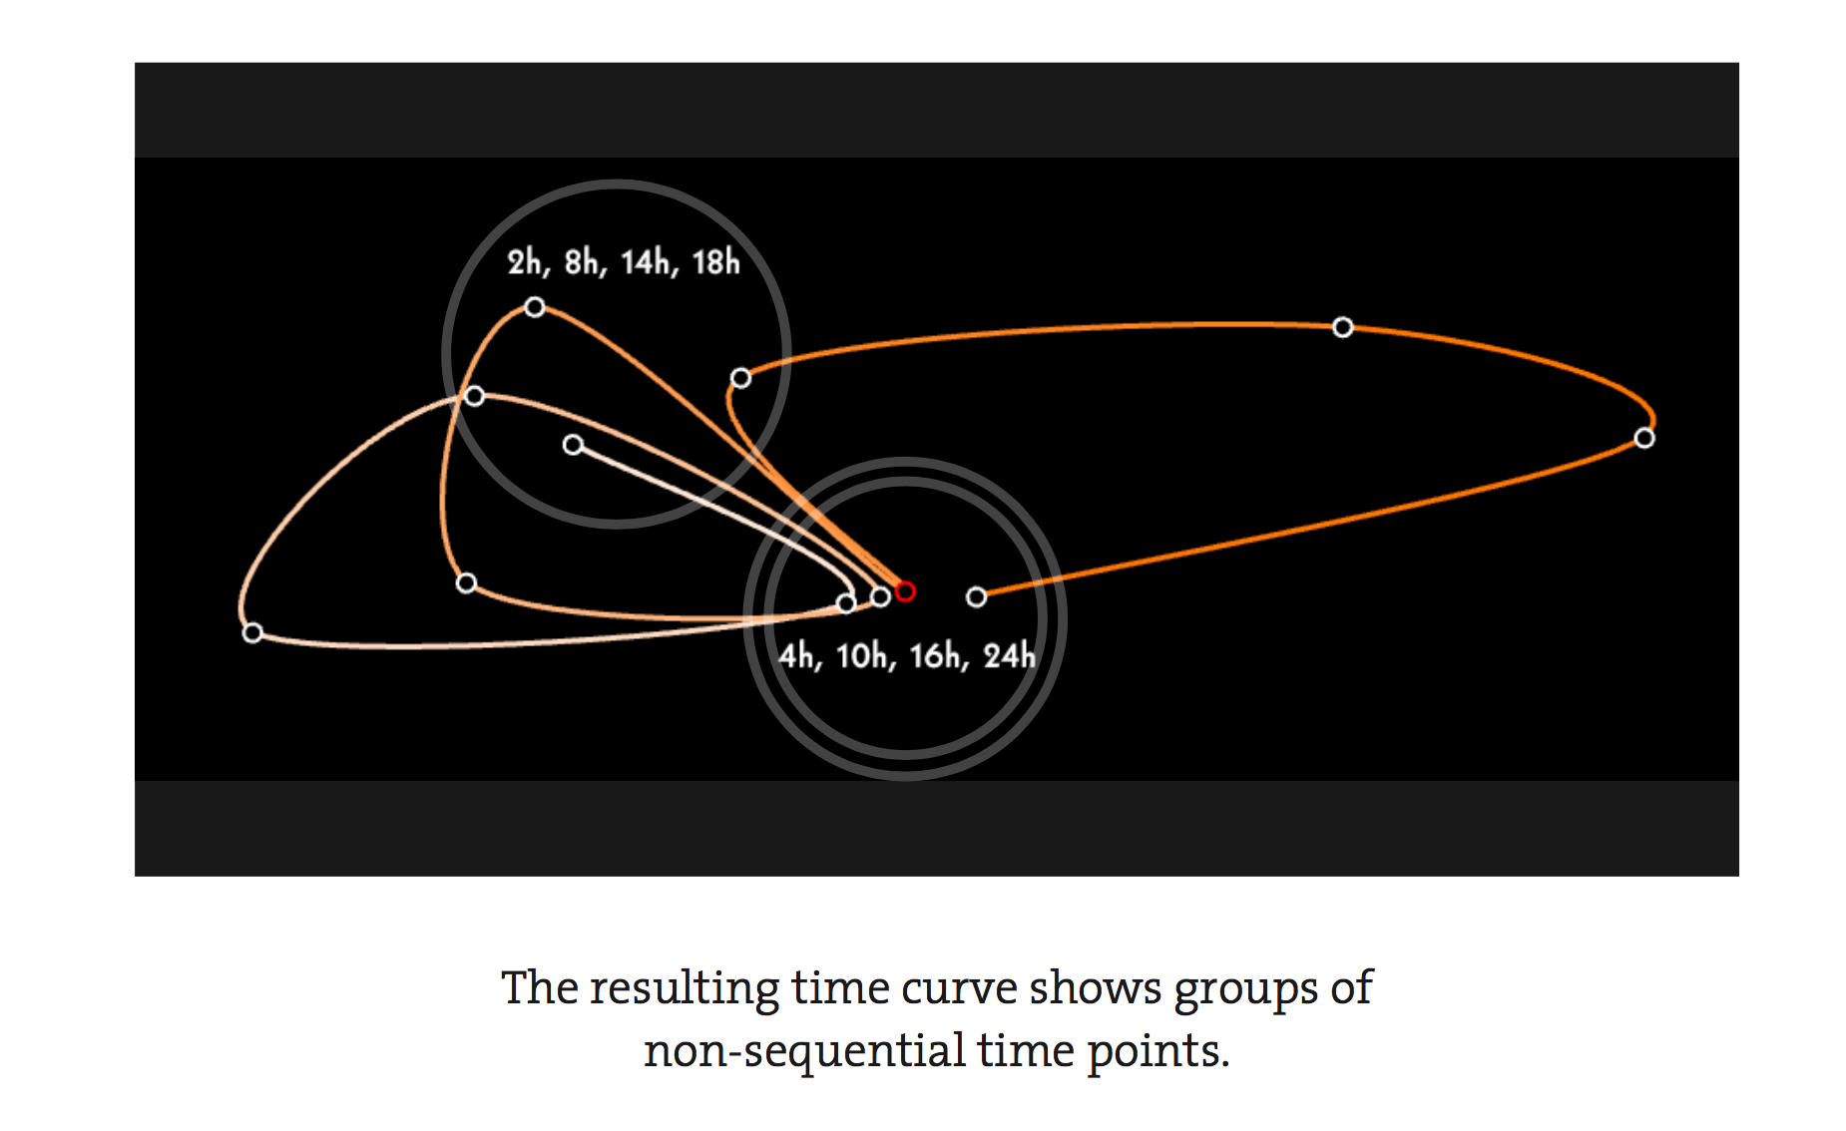
Visual representation
https://www.youtube.com/watch?v=Y6RfKjU1kM0

Slide 22
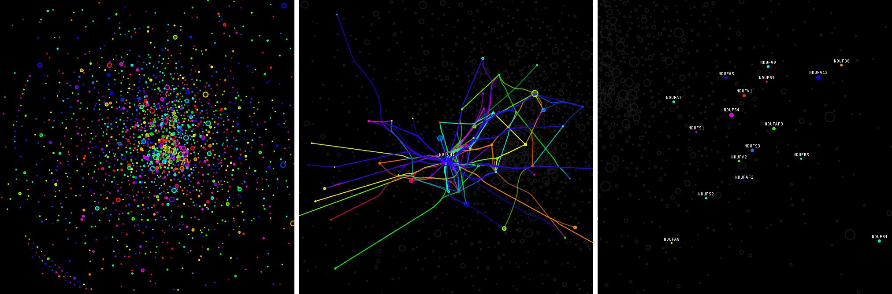
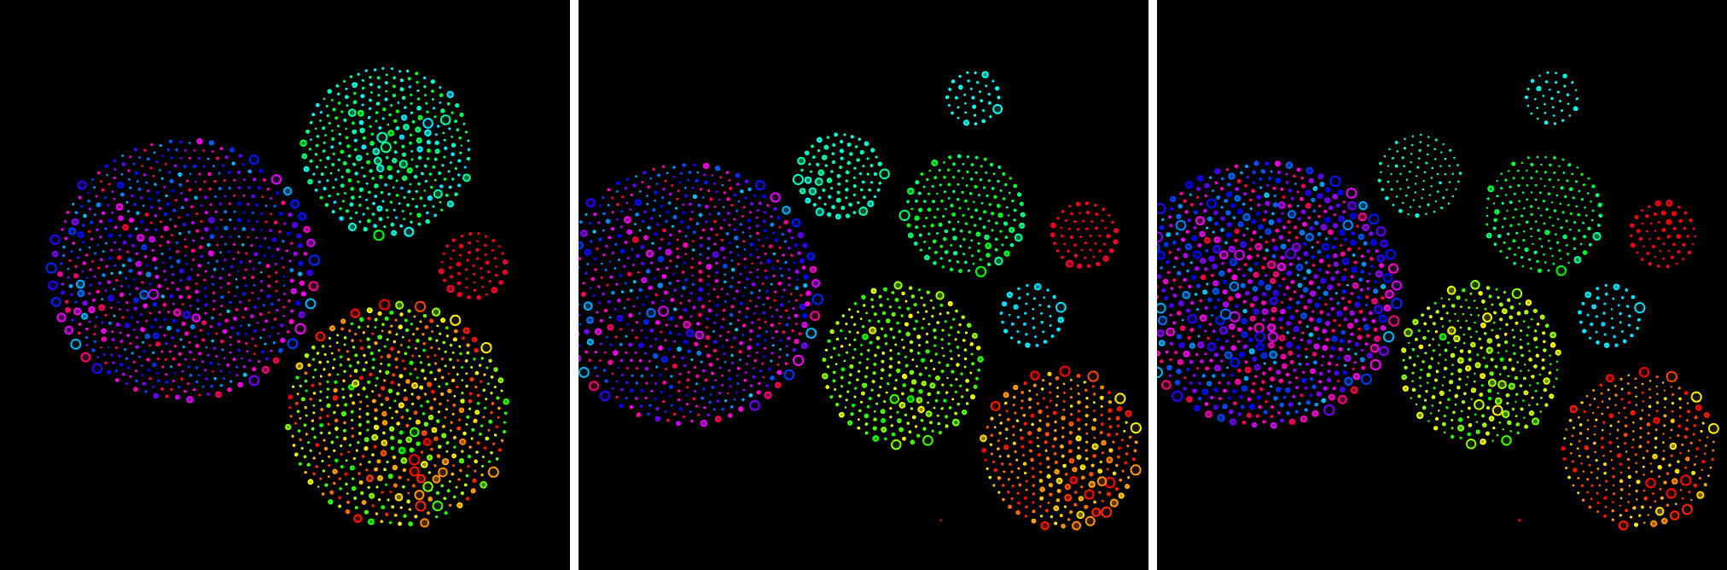
Visual representation

Slide 23
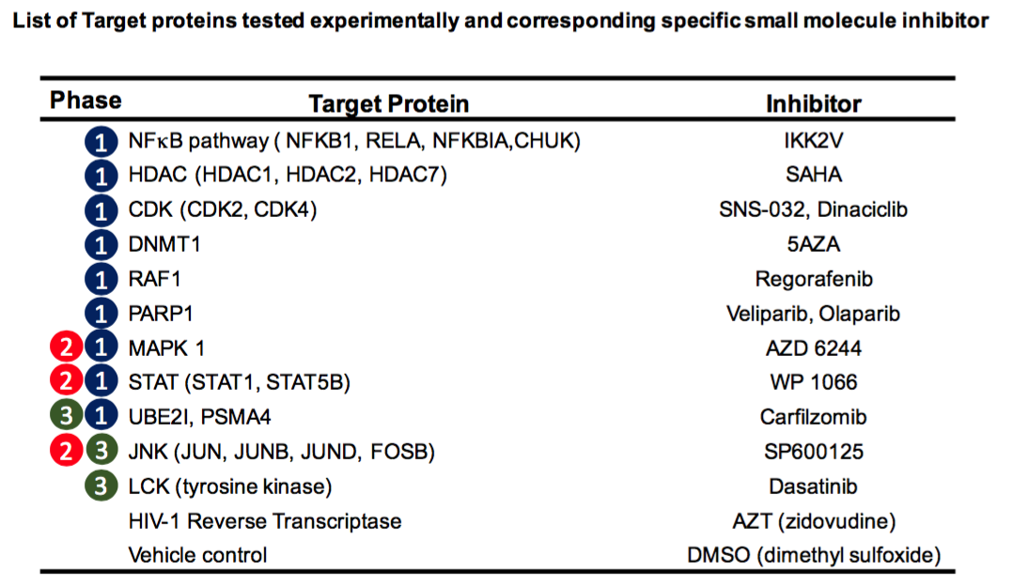
Experimental validation: Inhibitors

Slide 24
Experimental validation: Results
Notes:
AZT - Zidovudine

Slide 25
Challenges
TimePath is fully based on the molecular data, thus could be applied to much shorter time scale.
Therefore it enables to obtain a more fine resolution of the disease stage.
Blocking proteins, at any phase, leads to reduction in viral load
Blocking specific proteins has a positive impact only if they are targeted at the phases predicted by TimePath
Reinforces the importance of temporal models for preventing and treating infections.
In silico results are consistently good both for HIV and flu H1N1
Lab validation was conducted (Pittsburgh University collaboration)

Slide 26
3. Drug target interaction

Slide 27
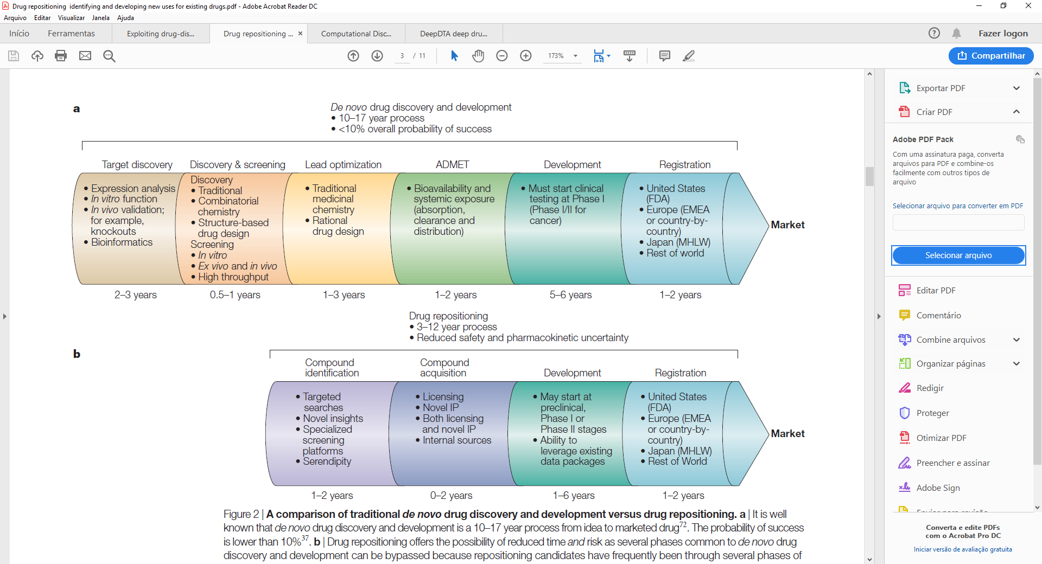
Drug discovery: De novo vs repositioning
Reward
Time
Traditional de novo drug discovery vs drug repositioning. Ashburn TT, Thor KB (2004) Drug repositioning: identifying and developing new uses for existing drugs. Nat Rev Drug Discov 3: 673-683. doi: 10.1038/nrd1468

Slide 28
Objectives
Establish a Deep Learning approach to discover new leads (hit compounds)
Exploit the particular ability of Convolutional Neural Networks (CNNs) to obtain 1D representations (local dependencies or patterns) from protein sequences and SMILES
Develop a pipeline with two parallel Convolutional Neural Networks (CNNs) to uncover deep patterns (representations) from raw data instead of the conventional descriptors
Implement a DTI predictor

Slide 29
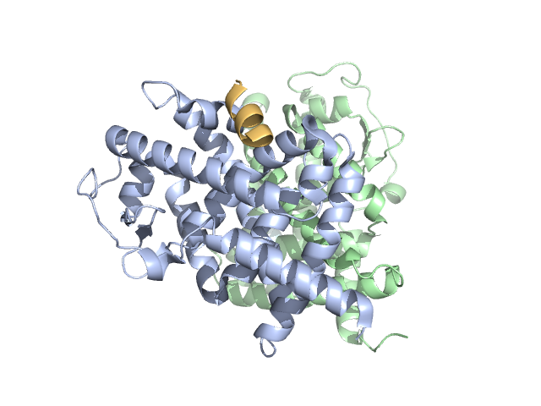
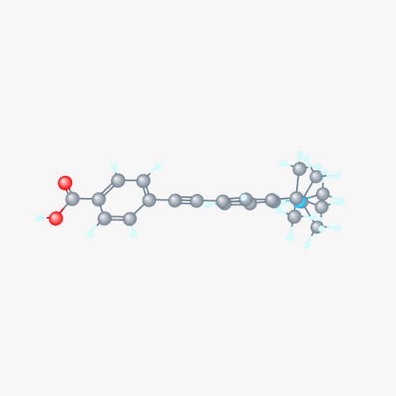
Drug-target interaction
Retinoic Acid Receptor Beta (RARB)
4-(1-Isopropyl-4,4-dimethyl-1,2,3,4-tetrahydro-quinolin-6-ylethynyl)-benzoic acid
3D
Protein Structure
Compound Structure
DTI
1D
MTTSGHACPVPAVNGHMTHYPATPYPLLFPPVIGGL…
CC(C)N1CCC(C2=C1C=CC(=C2)C#CC3=CC…
Protein Sequence
SMILES

Slide 30
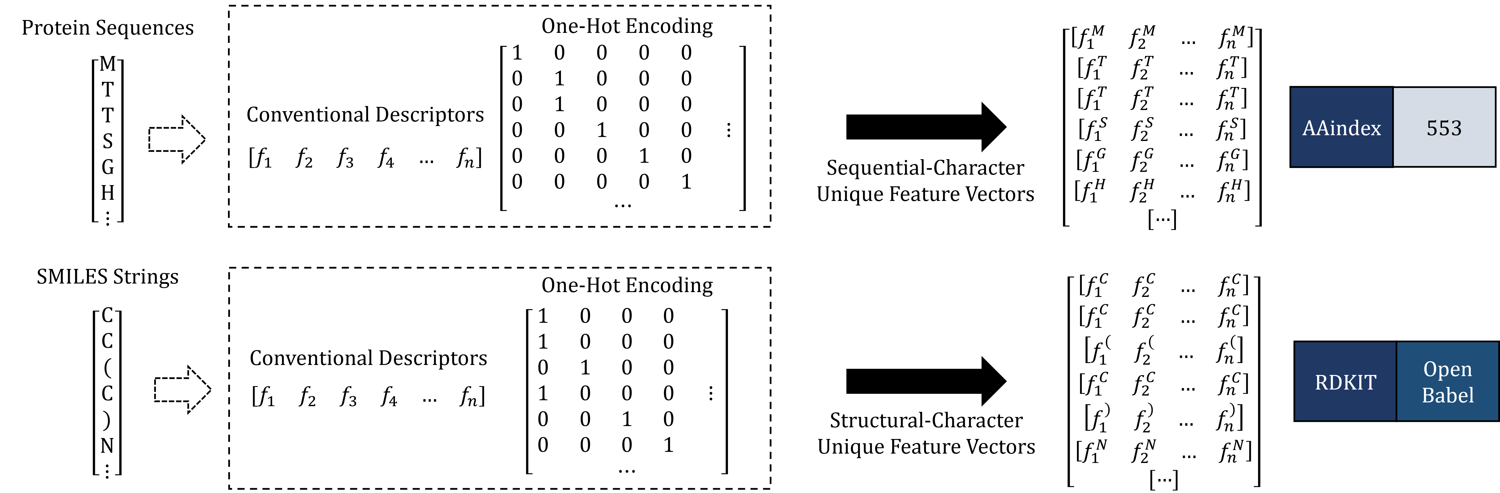
Data representation
Data representation methodology applied to protein sequences and SMILES strings, respectively, based on the use of unique feature vectors.

Slide 31
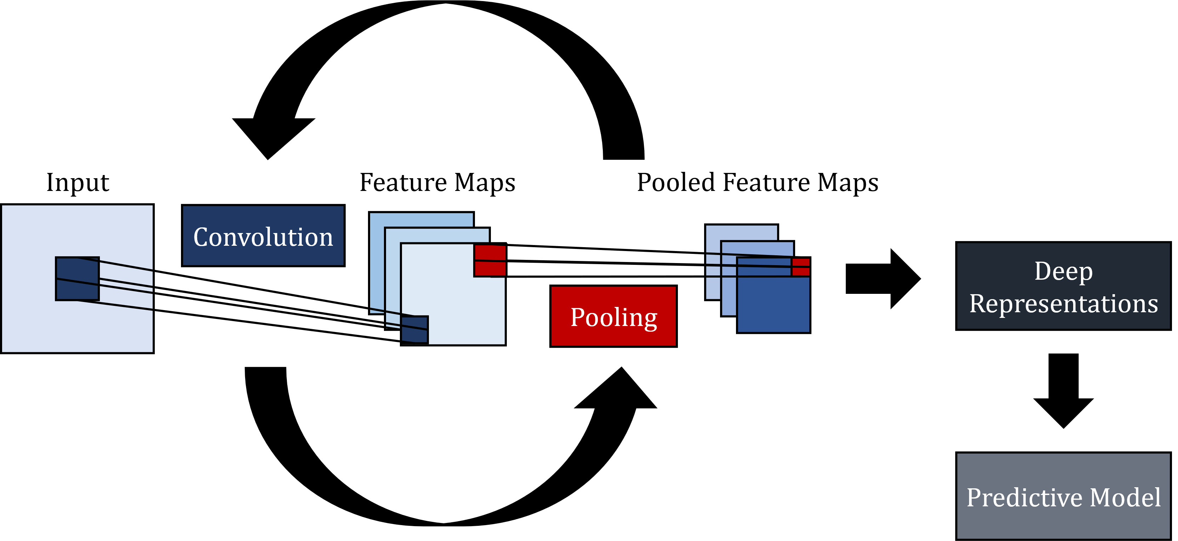
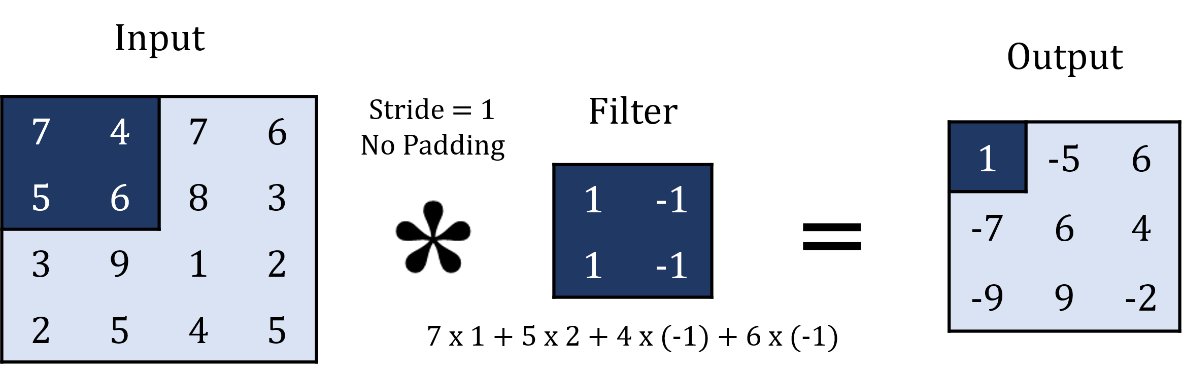
Convolutional neural network
CNN
Convolutional neural network architecture.
Convolution
Convolution operation.

Slide 32
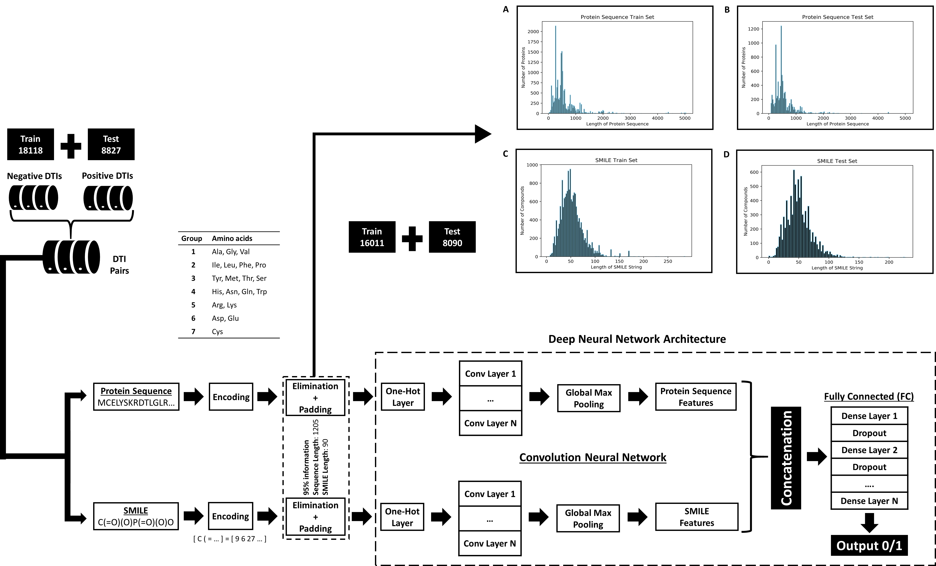
Pipeline overview
Figure 9 Diagram of the proposed pipeline..

Slide 33
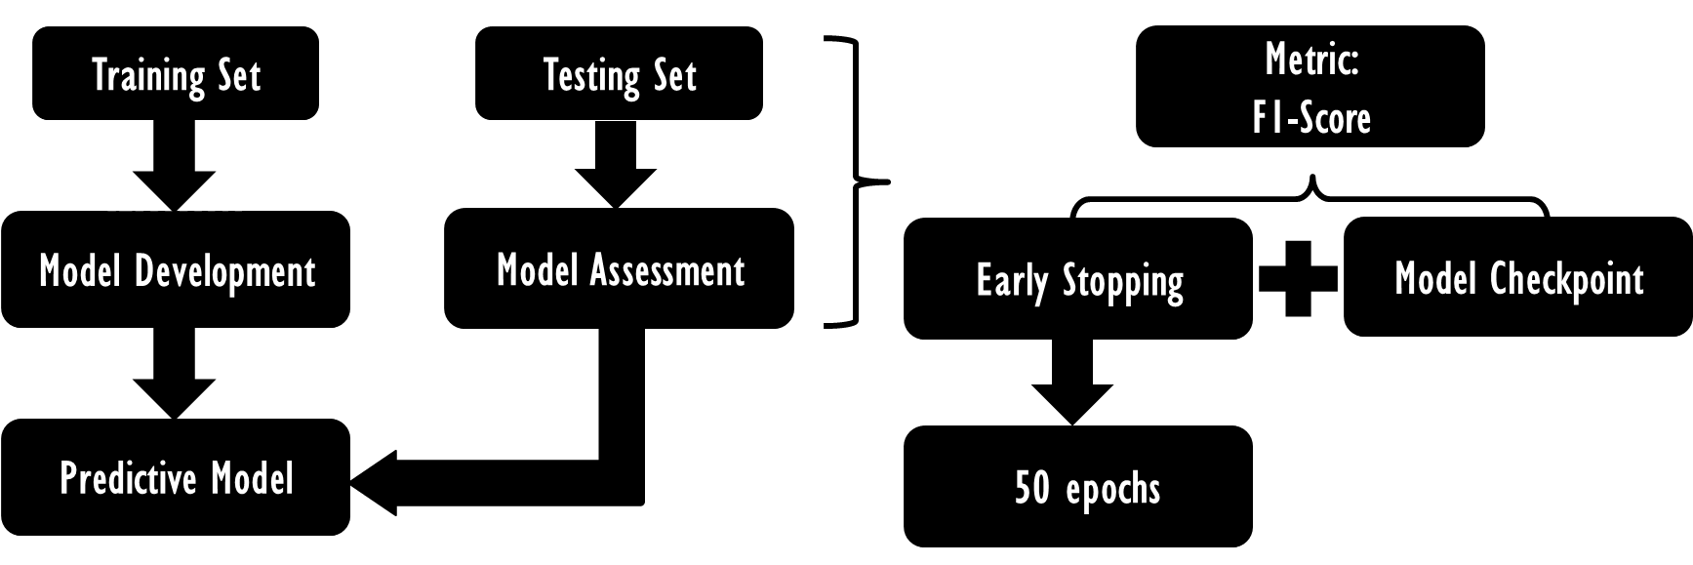
Hyperparameter optimization
Parameters | Value
Number of Convolutional Layers | 3
Number of Dense Layers (FC) | 3
Number of Filters | [48, 96, 144]
Filter Length (Proteins) | [3,4,5]
Filter Length (Compounds) | [3,4,5]
Epochs* | 500
Hidden Neurons | [128,128,128]
Batch Size | 256
Dropout Rate | 0,5
Optimizer | Adam
Learning Rate | 0,0001
Loss Function | Binary Cross Entropy
Activation Function (CNN) | ReLU
Activation Function (FC) | ReLU
Activation Function (Output) | Sigmoid
Class Weights (imbalanced classes) | {0: 0.36, 1: 0.64}
Grid Search
Figure 8 Diagram of the hyperparameter optimization model based on grid search.
Table 2 Parameter settings for the proposed model.* Initial number of epochs to allow convergence of the model, however early stopping and model checkpoint were used.

Slide 34
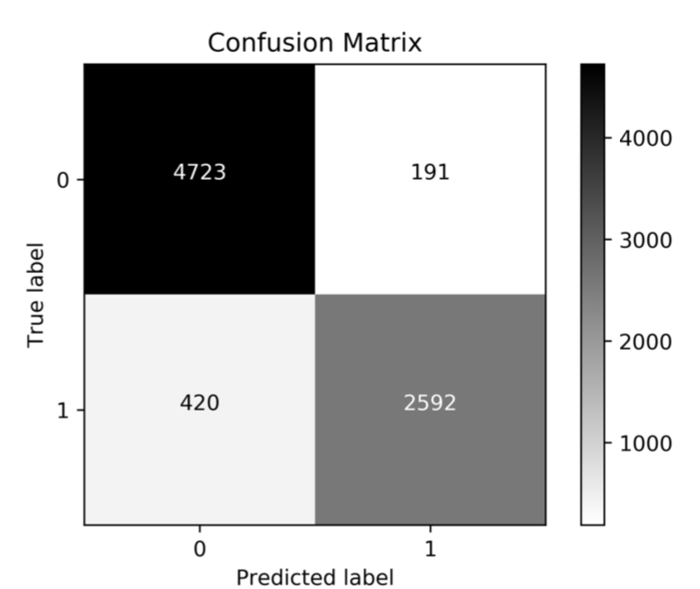
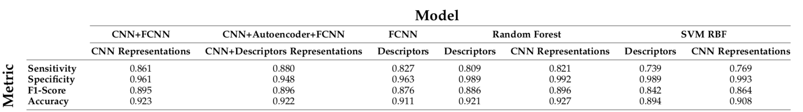
Model evaluation
Metric | End-To-End DL Approach | Descriptors +RF Coelho et al., 2016
Sensitivity | 0.861 | 0.809
Specificity | 0.961 | 0.989
F1-Score | 0.895 | 0.886
Accuracy | 0.923 | 0.921

Slide 35


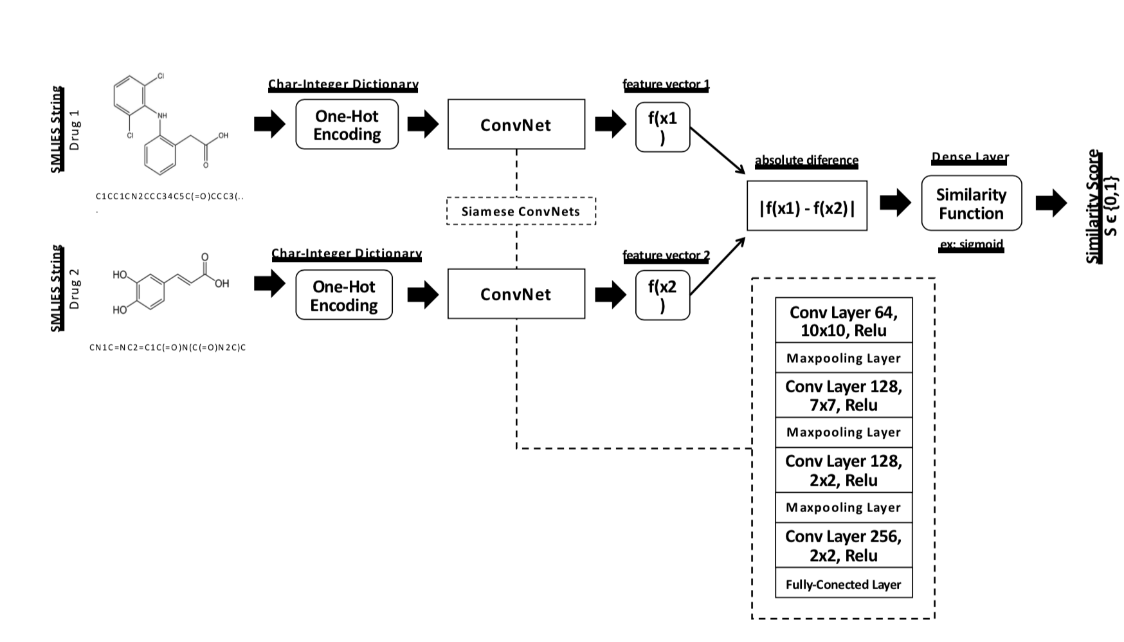
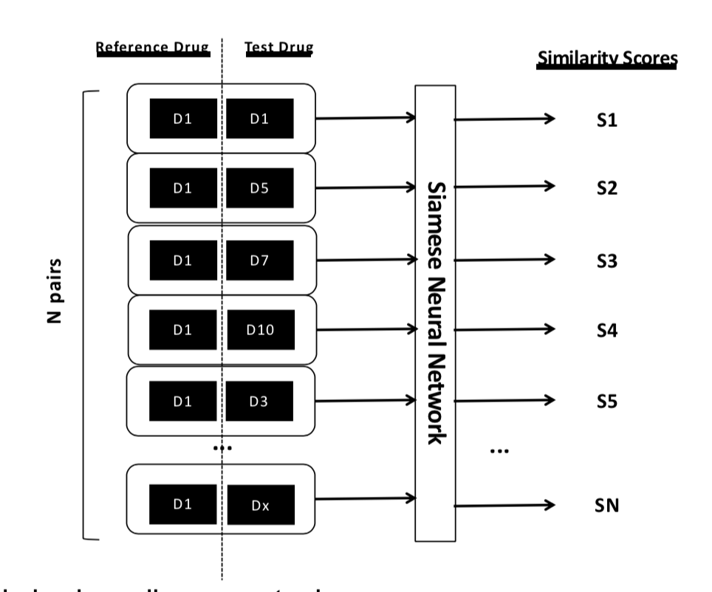

Slide 36
3. Targeted Generation of Compounds
Optimising Blood-Brain Barrier Permeation and Adenosine A_{2A} binding affinity

Slide 37
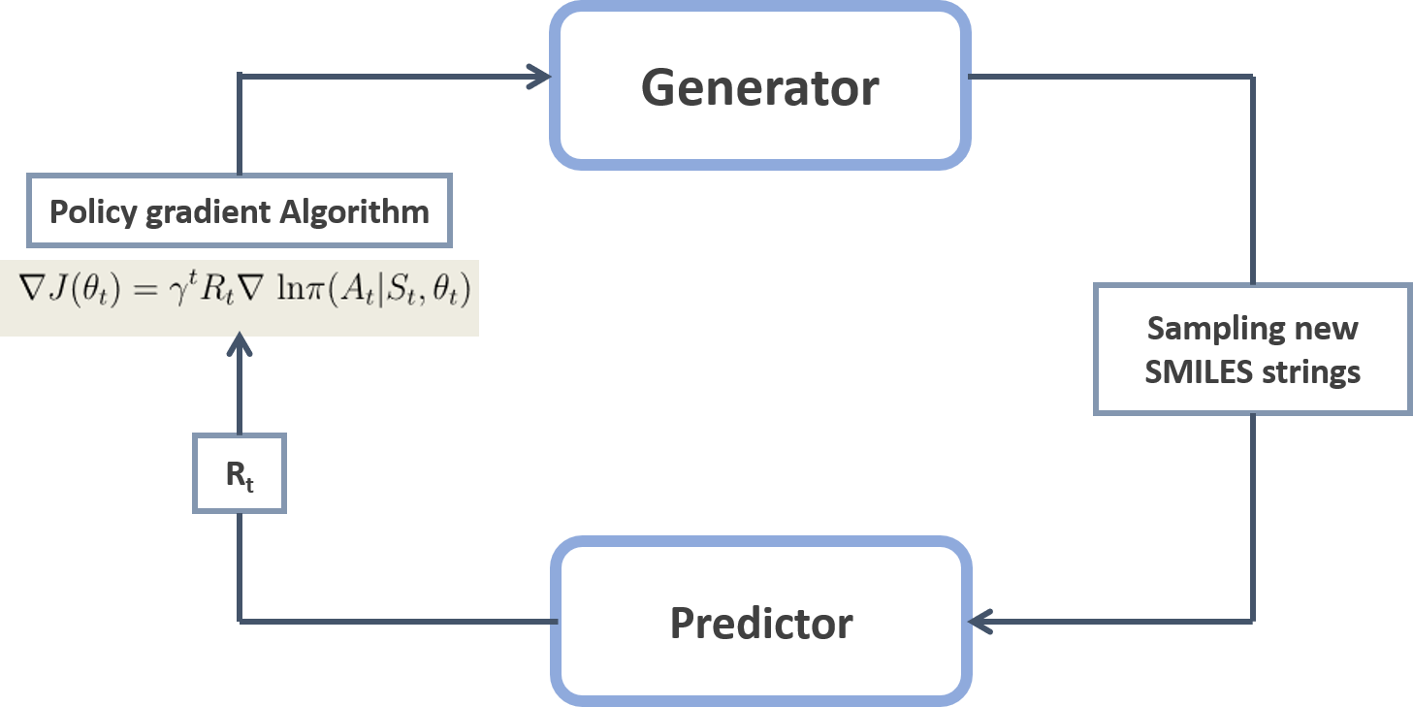
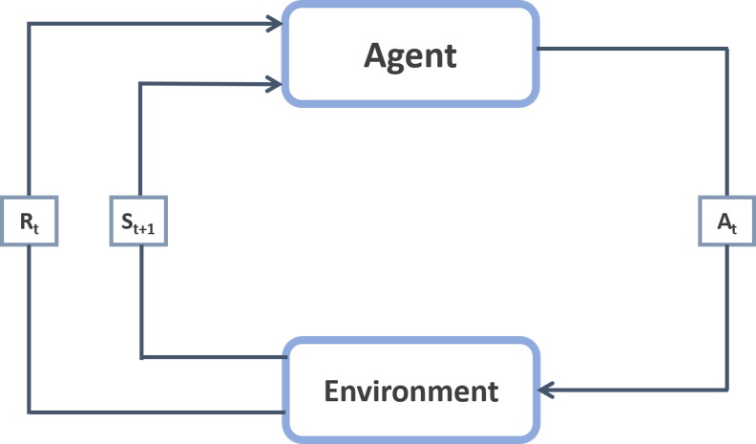
Deep Reinforcement Learning
Markov decision process (MDP)

Slide 38
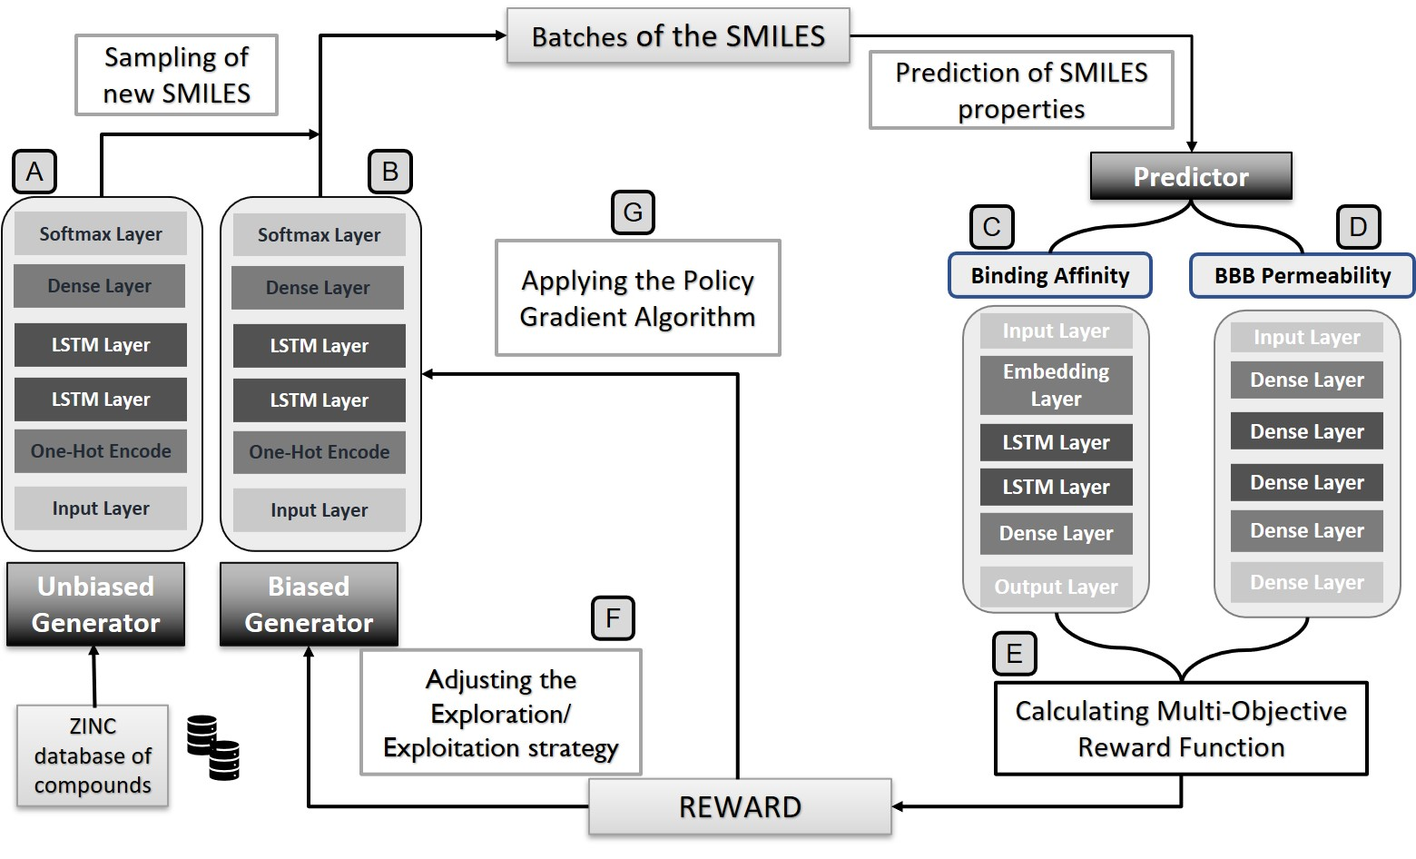
General workflow

Slide 39
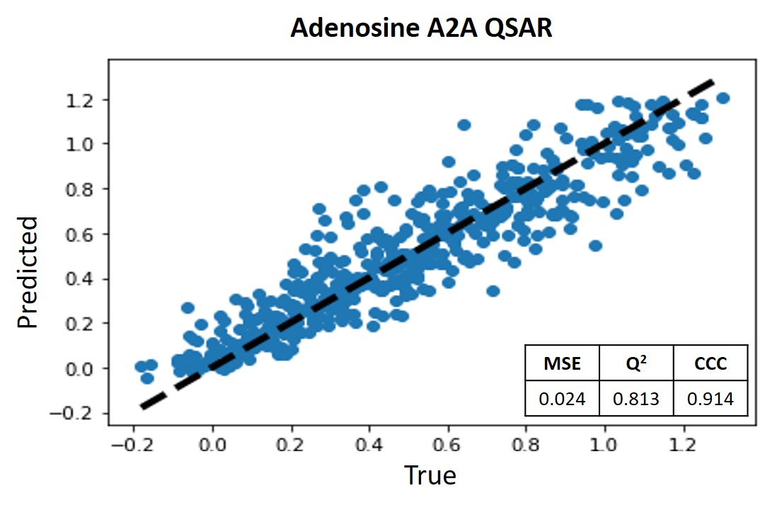
A. Generator unbiased
Parameter | Value | % valid | Internal diversity | External diversity | % unique
Epochs | 25 | 94.7 | 0.905 | 0.911 | 99.1
Batch size | 16
Dropout rate | 0.3
Number of Units | 256
Softmax Temperature | 0.5
Optimizer | Adam
C. Predictor for Binding Affinity
499,915 SMILES strings from Zinc database
D. Predictor for BBB permeability
Descriptor | Oversampling | Acc | AUC | Spe | Sen | MCC
SMILES | ADASYN | 0.924 | 0.955 | 0.818 | 0.958 | 0.788
SMILES | SMOTE | 0.913 | 0.928 | 0.737 | 0.952 | 0.722
ECFP | ADASYN | 0.935 | 0.922 | 0.859 | 0.963 | 0.829
ECFP | SMOTE | 0.944 | 0.971 | 0.898 | 0.951 | 0.834
39
39

Slide 40
Deep Reinforcement Learning
Classical formalism
Targeted molecule generation formalism
Set of environment states (S);
Set of agent actions (A);
Policy (π);
Goal;
Reward (R).
Set of all SMILES strings;
Set of all tokens;
Trainable weights of the Generator model;
To bias the generator to produce molecules with the desired properties;
Numerical value obtained from the Predictor.

Slide 41
Multi-Objective Optimization setup
Multi-Objective Optimization
Affinity for Adenosine A_{2A} receptor
Permeability through Blood-Brain Barrier
Scalarization

Slide 42
Non-dominated solutions
Technique | Weight A2D | A2d biasing | BBB biasing | Valid (%) | Diversity | Unique (%)
Chebyshev | 0 | 0.154 | 0.343 | 94.4 | 0.827 | 77.8
Chebyshev | 0.2 | 0.503 | 0.239 | 83.2 | 0.769 | 77.9
Chebyshev | 0.3 | 0.420 | 0.182 | 88.6 | 0.758 | 75.4
Chebyshev | 0.5 | 0.530 | 0.328 | 90.0 | 0.783 | 76.3
LWS | 0 | 0.199 | 0.225 | 85.6 | 0.795 | 84.1
LWS | 0.1 | 0.277 | 0.352 | 76,6 | 0.819 | 77.1
LWS | 0.6 | 0.313 | 0.201 | 87.8 | 0.807 | 85.3
LWS | 0.8 | 0.280 | 0.121 | 79.4 | 0.801 | 83.9
Table 2. Comparison of the non-dominated solutions obtained for each scalarisation technique.

Slide 43
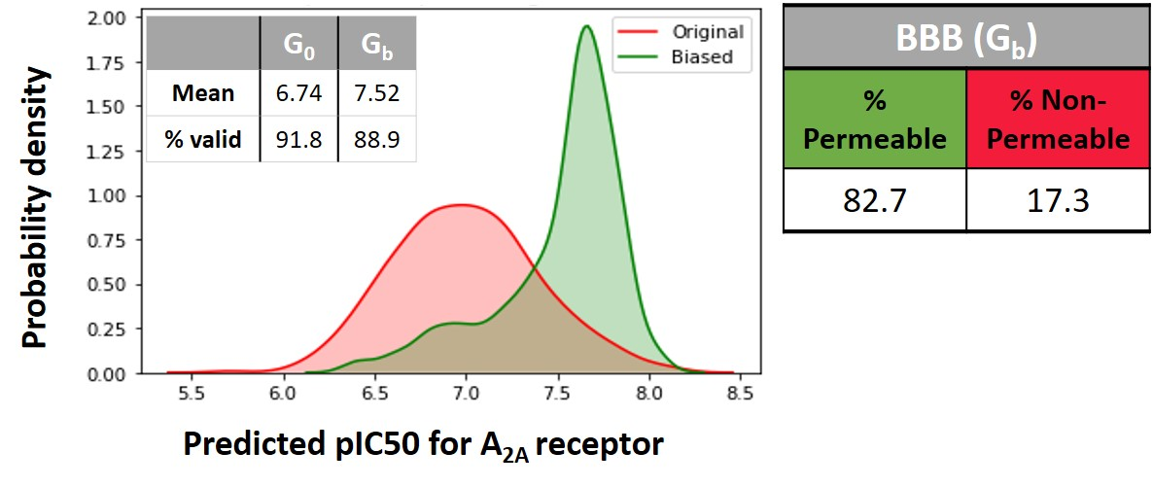
Multi-Objective Optimization Results

Slide 44
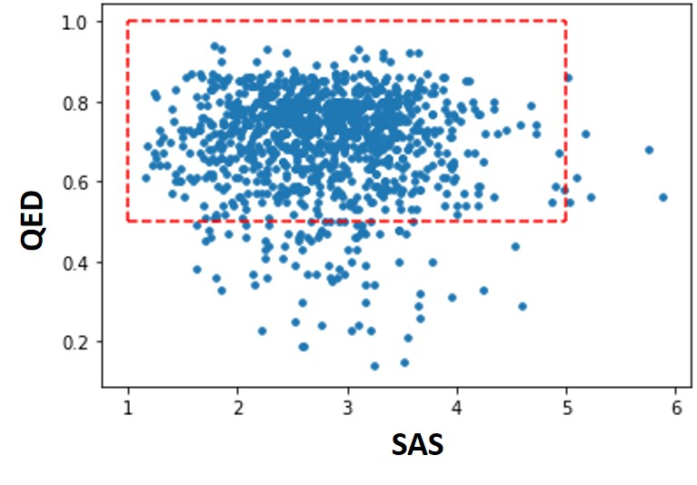
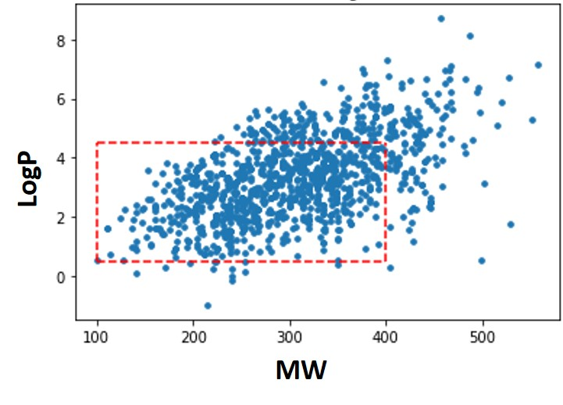
Multi-Objective Optimization Results
Evaluation of specific key properties – Generation of 1000 molecules
Notes:
Quantitative Estimate of Druglikeness (QED)
Synthetic accessibility score (SAS)
partition coefficient (logP)
MW (molecular weight)

Slide 45
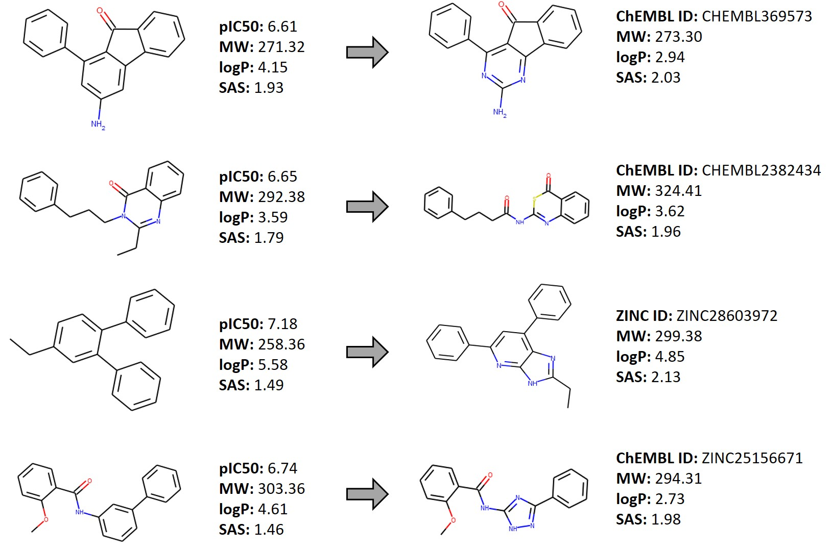
Multi-Objective Optimization Results

Slide 46
4. Generation of compounds guided by the transcriptomic data
Ubiquitin-specific Protease 7 (USP-7)

Slide 47
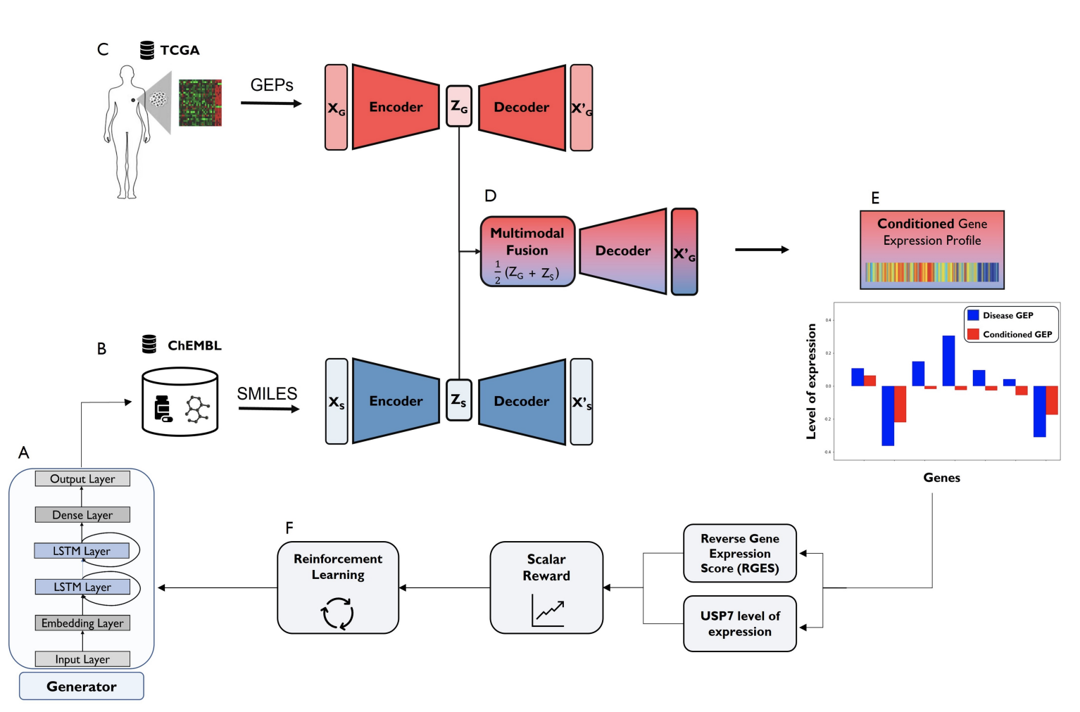
Ubiquitin-specific Protease 7
Ubiquitin-specific Protease 7 (USP-7) is a promising target for cancer.
Generate candidate molecules that modulate the Gene Expression Profiles (GEP)
Use of Variational Auto-Encoders to evaluate expression profiles

Slide 48
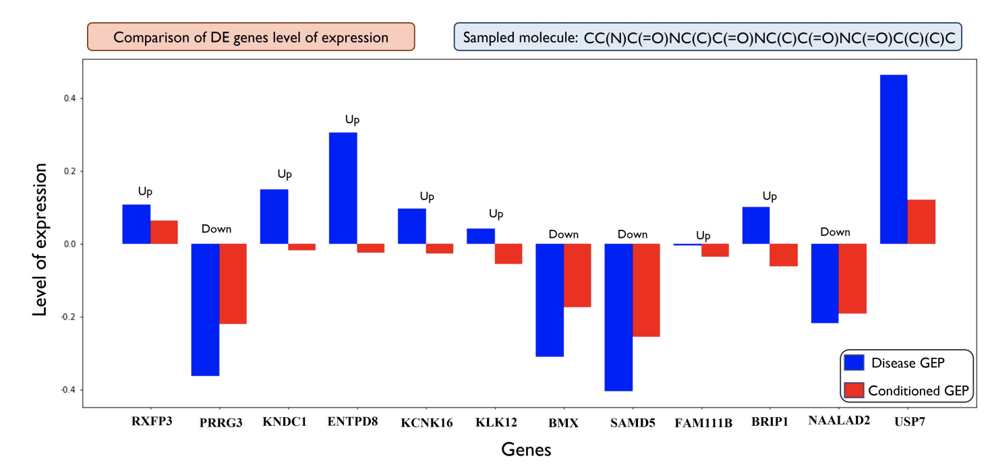
Analysis of the expression level of DE genes
Comparative analysis of the DE genes expression (up and down-regulated) in the initial disease GEP (blue) and in the GEP conditioned by the sampled molecule (red).

Slide 49
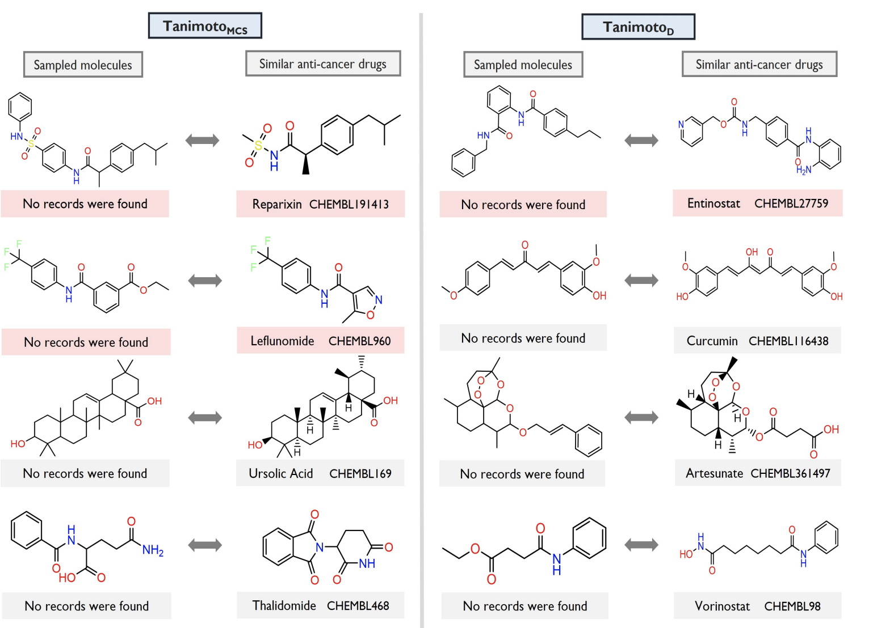
Sampled molecules vs. anti-cancer compounds

Slide 50
5. Global vision

Slide 51
Protein target plus:
- Base fragment
- Parameterization
- Other restrictions
Generative model
Reward function
(ex. binding affinity)
CC(C)(C)c1nc(NC(=O)Nc2ccc(-c3ccncc3)cc2)no1
Evaluation Model
Candidate molecule
COc1ccccc1Nc1nc(N2CCOCC2)c2ncn(C(C)C)c2n1

Slide 52
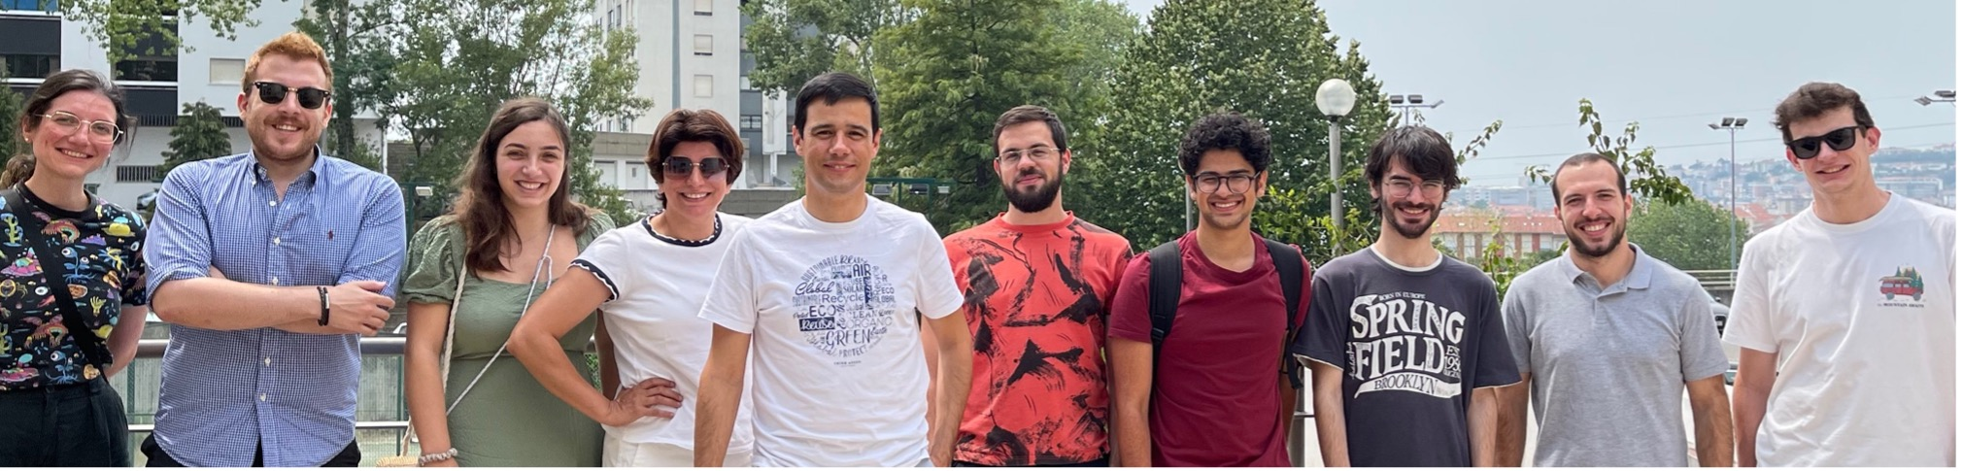
Team @University of Coimbra
Joel P. Arrais (Assistant Professor, DEI)
Maryam Abbasi (Researcher, DEI)
António Cruz (PhD student, Comp)
Nelson Oliveira (PhD student, Biomed)
Luís Torres (PhD student, Biomed)
Tiago Pereira (PhD student, Biomed)
Daniel Martins (PhD student, BioInf)
Fabiano Papaiz (PhD student, Comp)
Anuschka Spínula (PhD student, Med)
Elmer Carlos(MSc student, BioInf)
Gonçalo Coelho(MSc student, CompSci)
Raúl Sofia (BSc, BioChem)

Slide 53
Artificial Intelligence for the targeted generation of novel compounds
Joel P. Arrais – jpa@uc.pt https://joelarrais.github.io
DEI/CISUC - University of Coimbra

